Slide 1
CDS Evaluation
Module — Developing Workflow Diagrams and Scenarios
Notes:
Instructor and learner introductions

Slide 2
Module Objectives
By the end of this module, you will be able to:

Slide 3
Evaluation Goals
Understand what work gets done
Understand how that work gets done
Understand who does it
Understand how the “team” works together to get the work done
Understand how the work flows
Understand how the information flows
Understand which tools are used

Slide 4
Define Workflow

Slide 5
Flowcharts: the basics
Basic Shapes
Beginning or End
Activities
Process Flow Direction
Decision
Delay
Document
Moresteam, 2017
Notes:
There are more shapes you can use but these the most common ones.

Slide 6
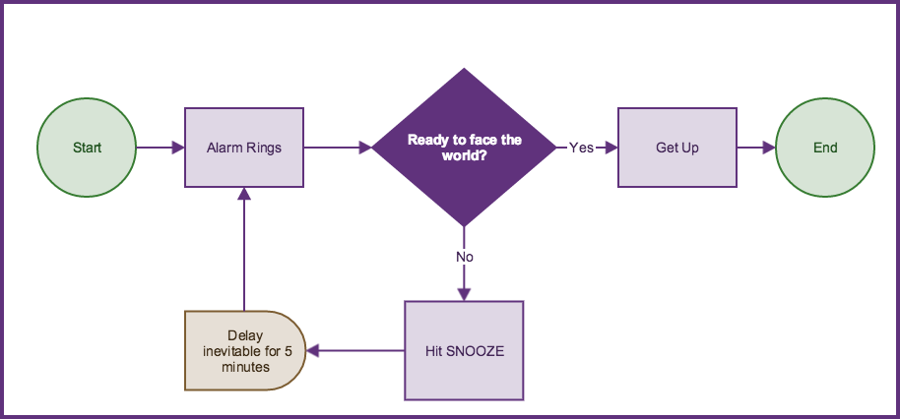
Example of simple Flowchart
Kushner, 2016
Notes:
This is very simple. Your alarm goes off. If you’re ready to face the world then you get up. If not, you hit the snooze and it loops back to alarm ringing again. After the snooze is over then you have to decide if you’re ready to face the world and this keeps looping until you decide yes.

Slide 7
Workflow Diagram Is A Type of Work Model
Simple CDS Workflow
Obtain Data
Decide
Perform Action
Start
Stop
Analyze Data
Some event initiates the work
CDS user obtains data on which to make a clinical decision
Clinician reasons about patient using available data
Clinician makes a decision
Clinician acts on the decision
Clinician documents the decision
The work is complete

Slide 8
Workflow Follows Narrative
Workflow follows the narrative of the primary user role obtained during earlier interviews
Example (Physician):
“I receive a notification that results are available for a laboratory panel ordered for my patient. I pull up the results in CPRS and review the lab results in the context of my patient’s prior tests and current condition. I then decide on which specific drug or treatment the patient should receive. I then order a prescription for that treatment and write a note in the patient record to document my decision .”
Note that the end of one work process often signals the start of another (in this case, for Pharmacy).

Slide 9
Workflow Diagram Is A Type of Work Model
Simple CDS Workflow: Ordering a medication after labs
Obtain Data
Decide
Perform Action
Start
Stop
Analyze Data
Physician receives notification of lab results
Physician navigates to new lab results, prior lab results, and other relevant data from patient record
Physician determines what the new data adds to the patient diagnosis, weighs treatment options for expected efficacy and risk.
Physician decides on a treatment option
Physician completes a medication order
Physician documents the treatment decision in the patient record
This part of the work is complete

Slide 10
A common Pattern for CDS Workflow
Obtain Data
Decide
Perform Action
Start
Stop
Analyze Data
This common pattern for decision making is central to workflow for almost any form of CDS
An initiating event
Obtaining sufficient information
Analyzing that information
Making a well-informed decision
Acting on that decision
Confirmation that the action was successful
CDS interventions are typically designed to augment or automate some portion of this pattern

Slide 11
Documenting Informatics TouchPoints
[Add EHR swimlane to process to document informatics touch points]

Slide 12
Documenting Supporting Work ROles
[Add Nurse swimlane to process to document collaboration and communication]

Slide 13
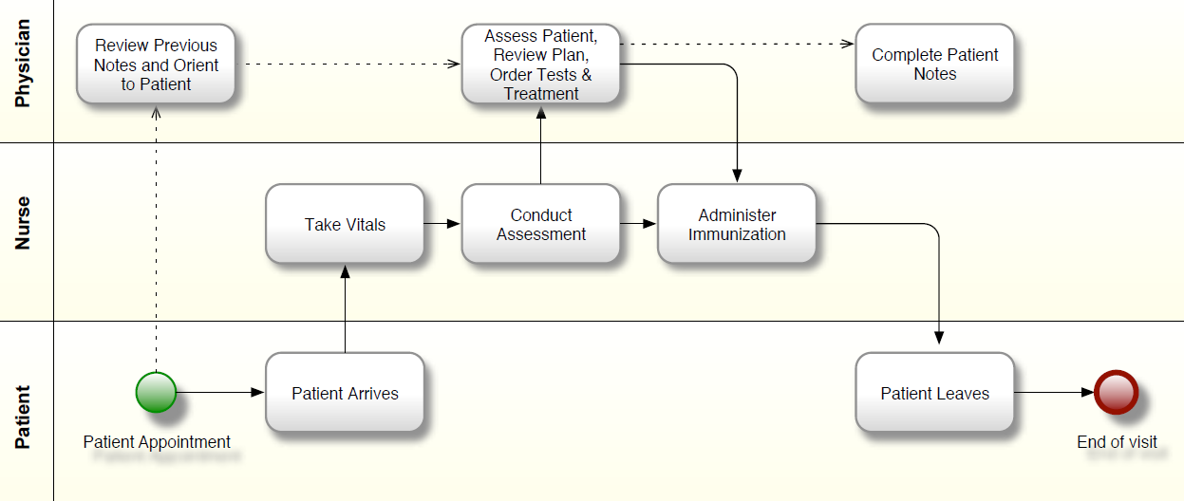
Diagraming Patient Flow
Notes:
Scott

Slide 14
Resources for Workflow Tools
Paid & Open-Source Tools
Many available software packages
LucidChart
Gliffy
Visio (VA approved, requires special request)
PowerPoint
Often easiest to start by sketching it out on paper
Notes:
From: mod 7
The VA is moving toward BPMN. This is a specific type of modeling for workflows that can be useful.
Add image of hand-drawn workflow

Slide 15
The Two Key Work States to Model
The AS-IS state is the workflow in place before the CDS intervention
Represents and includes information from Question 3 of the Value Proposition
Q3: What is currently done and why is it not good enough?
The TO-BE state, is the workflow after the CDS intervention
Represents and includes information from Question 4 of the Value Proposition
Q4: What is the proposed solution and how does it overcome the problem?
New CDS always has the potential to change the As-Is workflow, but sometimes it will not.

Slide 16
As-Is/To=Be Example
[show example how new CDS can change workflow]

Slide 17
Contrast As-Is/To-Be with ED Template Example
[show portion of ED As-Is]
[show portion of ED To-Be]
[describe contrasts]

Slide 18
Prepare for Assessment
Select Tools and Instrumentation
Write Scenarios
Naturalistic observations: Scenarios are not used.
Create Tasks
Naturalistic observations: Tasks can be more general or represent a user’s goal (“Show me how you order metformin”).
Controlled observations: Tasks should be specific and discrete (“Navigate to the orders module. Select metformin. Place the order.”).
Controlled observations: Scenarios may be required to guide participants through certain tasks and set the stage for the CDS interaction.
Tasks may be combined with scenarios.
Notes:
Having a scenario gives the participants context when they are in a controlled setting.
You want to create a set of tasks that will allow you to observe how the participant interacts with the CDS intervention and address assessment goals.

Slide 19
Write Scenarios and Create Tasks for an Evaluation
Notes:
See Cooper 4ed, p102, Scenarios: Narrative as a Design Tool

Slide 20
Prepare for assessment
Scenarios
Scenarios are a story or narrative to set the stage for interactions with CDS interventions
Represent actual work and a likely setting
Include characters (e.g., staff, patients)
Include typical kinds of activities participants would complete
Notes:
The more realistic the scenario is, the more meaningful your data will be because participants will be able to treat the observation more realistically.

Slide 21
Prepare for assessment
How to Write a Scenario
Decide on the purpose
Choose the most relevant setting, characters, activities related to the purpose
Use frequent activities
Include all activities necessary to complete a goal
Informal observations provide great information for scenarios
Use a logical, typical sequence

Slide 22
Prepare for assessment
Sample Scenario
You just received a new patient from the ED on your medical–surgical ward. You need to document her admission assessment and determine her suicide risk to prepare any needed interventions or support she will require while she is an inpatient and prepare for her needs at discharge. The patient is a 62-year-old Veteran who lives alone. She has a history of diabetes Type 2 x 20 years, depression, and alcohol abuse.

Slide 23
Prepare for assessment
Sample Scenario
The patient and her neighbor enjoy having evening cocktails together each day. The neighbor noticed that the patient has been highly emotional lately and has been consuming significantly more alcohol than typical. The patient refused to go in for a routine examination. This morning, the neighbor found the patient passed out in the laundry room, where she apparently had spent the night. The neighbor became concerned when the patient said she wished she was dead, and brought her into the VA and dropped her off in the ED.

Slide 24
Prepare for assessment
Practical Exercise for Learners
Let’s look at the Mental Health Triage Evaluation SMARTForm (Suicide Risk)
Write a scenario for a suicide risk assessment
Consider:
Purpose
Setting
Characters
Activities
Notes:
Purpose: We’re looking at how users interact with CDS interventions, therefore our purpose is to find usability issues with the intervention. For user observations, we’re not evaluating the actual algorithms or accuracy of the intervention. Eventually, we will want to evaluate these things, but right now we just want to see how the users interact with the intervention.

Slide 25
Prepare for assessment
Tasks
Represent common activities for participants
Create a sequence that makes sense to participants
Tailored to the CDS intervention or application
Specific and discrete
Not “navigate around the interface” but
“Navigate to the vital sign section of the SMARTForm”
Notes:
Optimally, tasks are derived from end users or usability testing, or they are validated by actual end users.
Participants could see real patients as their task, or in a controlled setting they will complete tasks that you come up with.

Slide 26
Prepare for assessment
Tasks
Sample tasks for an eMAR are:
Order and modify medication(s)
Verify medication orders
Prepare medication
Access medication information/help
Administer and chart medication(s)
Generate reports and review eMAR
Staggers, Iribarren, Guo, & Weir, 2015

Slide 27
Prepare for assessment
Practical Exercise for Learners
Create a set of tasks for the SMARTForm on assessing suicide risk

Slide 28
Prepare for Assessment
Write Scenarios and Create Tasks
Refer to Module 4 for details on scenario and task creation
The patient and her neighbor enjoy having evening cocktails together each day. The neighbor noticed that the patient has been highly emotional lately and has been consuming significantly more alcohol than typical. The patient refused to go in for a routine examination. This morning, the neighbor found the patient passed out in the laundry room, where she apparently had spent the night. The neighbor became concerned when the patient said she wished she was dead, and brought her into the VA and dropped her off in the ED.
Tasks
Navigate to the Suicide Prevention SMARTFORM
Enter patient history data
Enter patient assessment data
Pull up the suicide risk assessment summary
Notes:
Evaluators may use tasks in summative usability testing or they may combine scenarios with tasks for participants to complete. This will depend upon the expertise of the participants.

Slide 29
Resources for flowchart Development
Video-based Tutorials
Institute for Healthcare Improvement (IHI) Open School
Creating a flowchart using Google drive
Creating a flowchart using Excel
Creating a flowchart using Microsoft Word
Notes:
These are basic tutorials to guide you through the process on flowchart development.

Slide 30
Example: eHMP 2.0 Medical Visit
VA Enterprise Health Management Platform (eHMP) 2.0 Example
Medical visit workflow assessment using screenshots and instructions
Notes:
These screenshots are taken from a workflow that has already created and you want a user to go through this workflow. It’s important to let the user know that you are looking for differences in workflow so if they notice something that is very different than how they normally do things, they should let you know. Sometimes you may have a user say that they have never even noticed a specific button before and then they can show you how they normally complete a task.

Slide 31
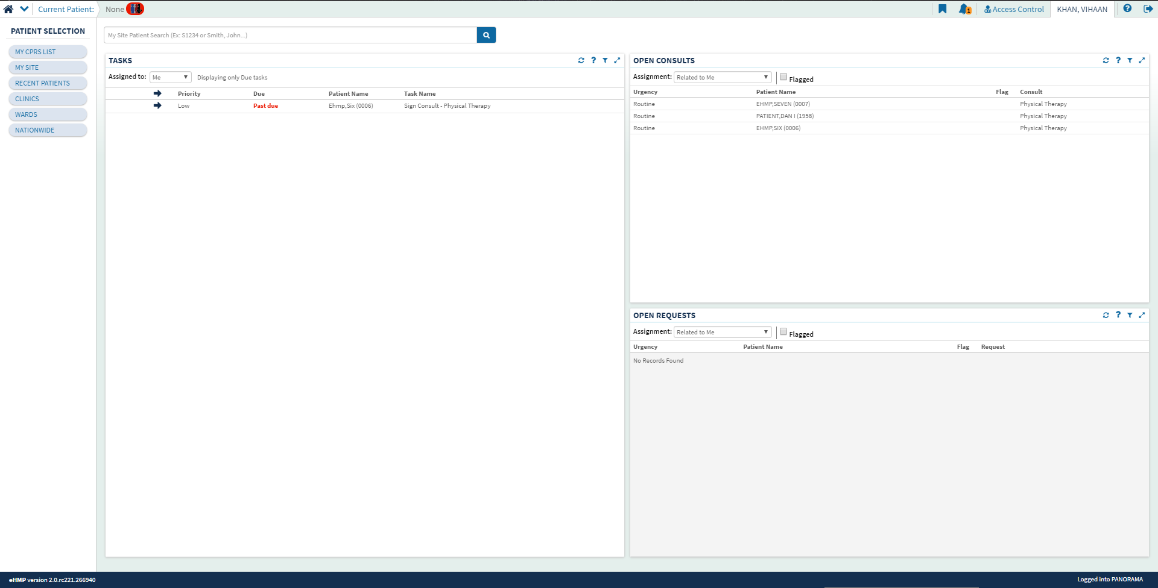
Example: eHMP 2.0 Medical Visit
Click on the “RECENT PATIENTS” button

Slide 32
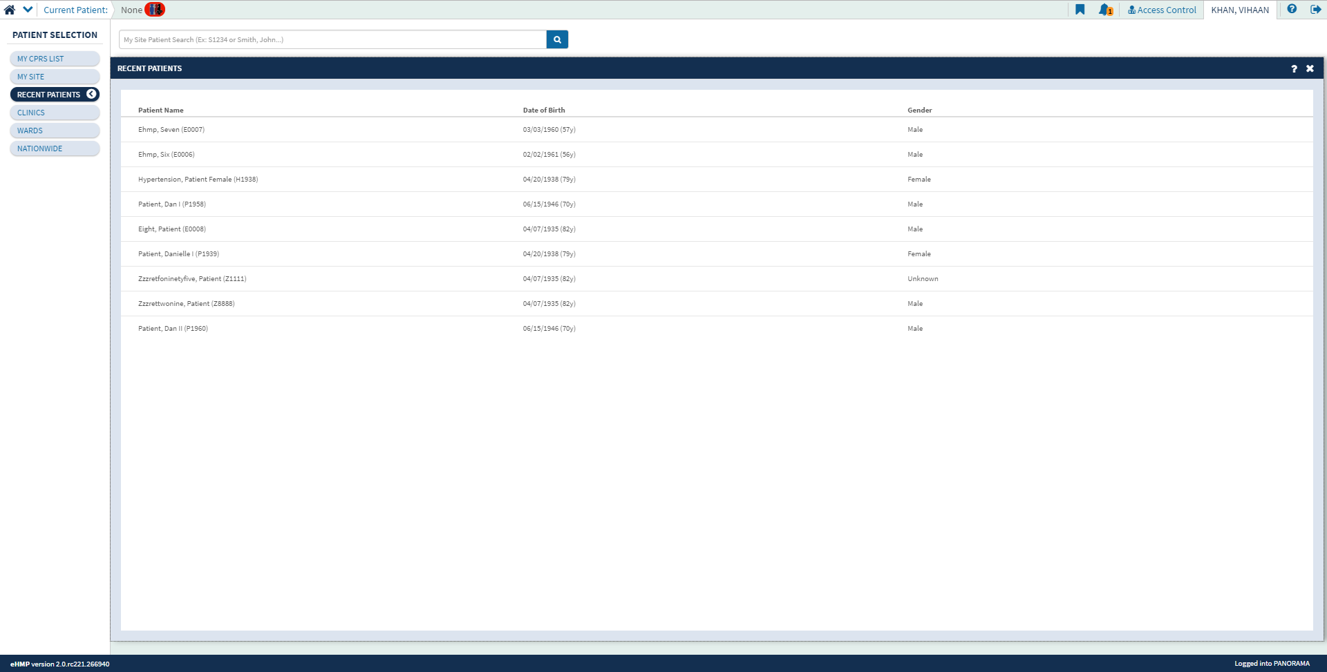
Example: eHMP 2.0 Medical Visit
Choose “Patient, Dan I”

Slide 33
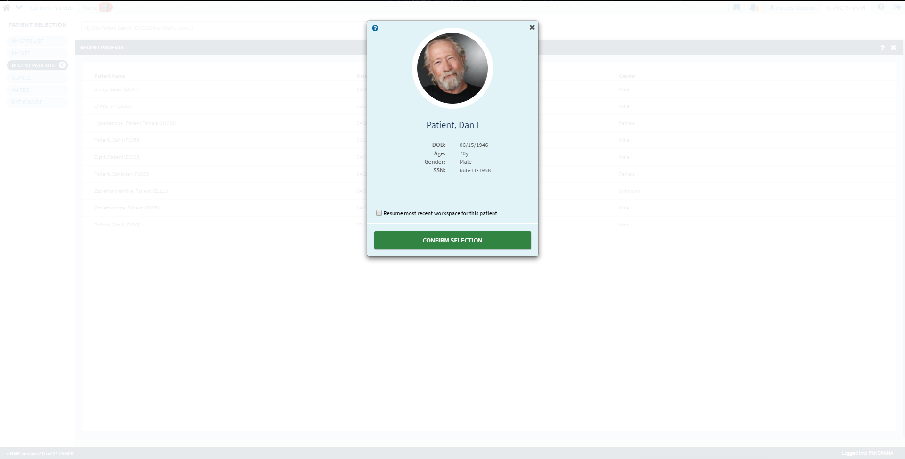
Example: eHMP 2.0 Medical Visit
Click on “CONFIRM SELECTION” button

Slide 34
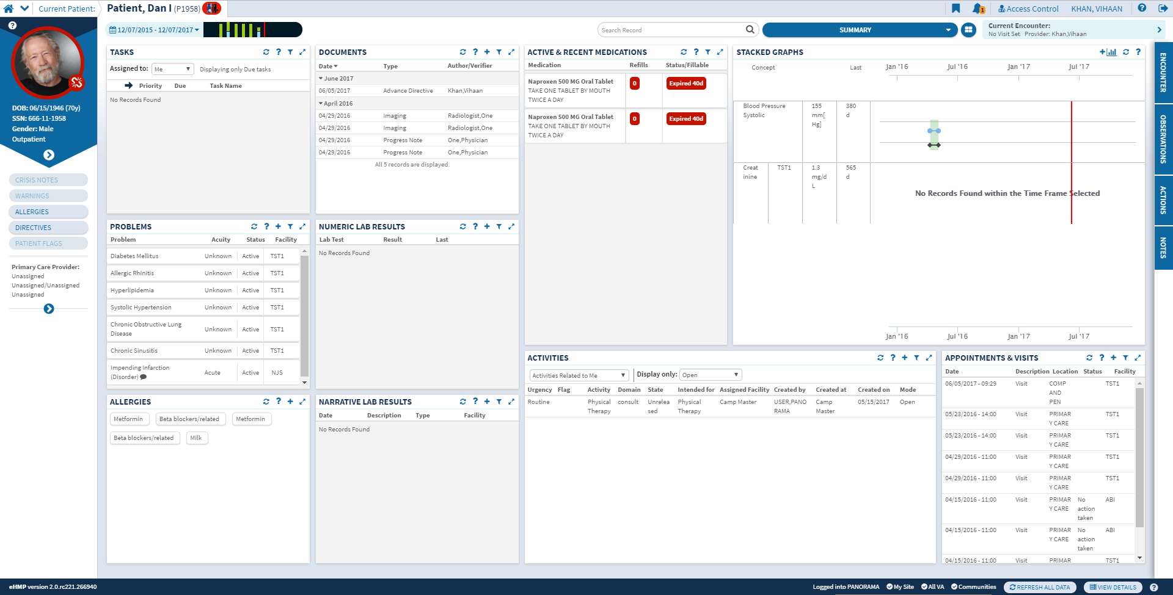
Example: eHMP 2.0 Medical Visit
Choose “ENCOUNTER” tab

Slide 35
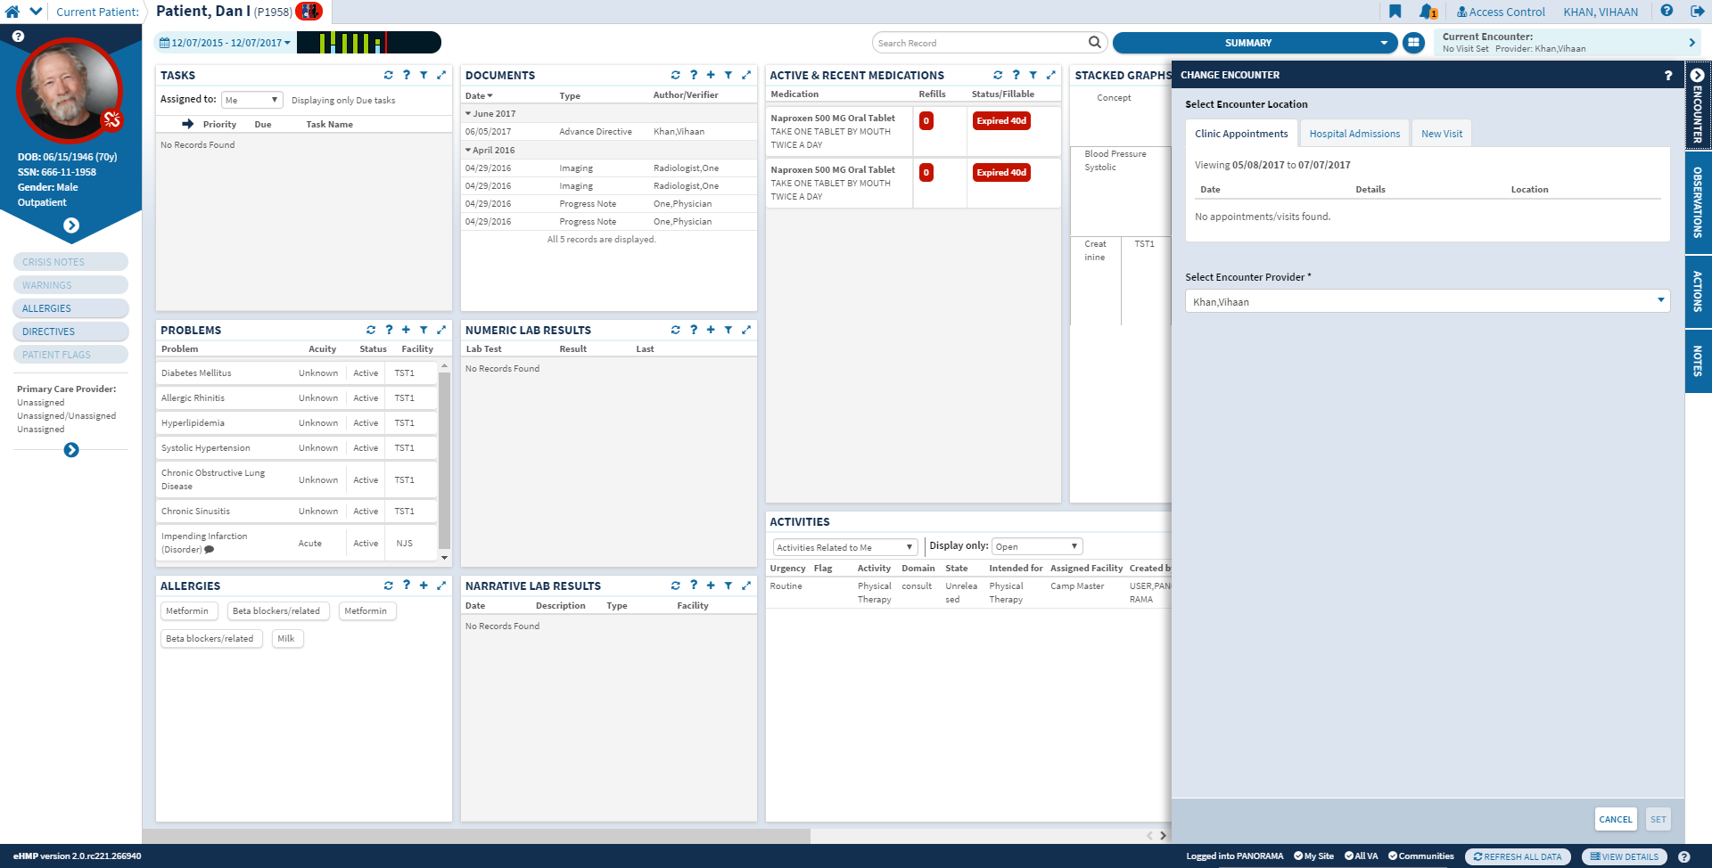
Example: eHMP 2.0 Medical Visit
Choose “NEW VISIT” button

Slide 36
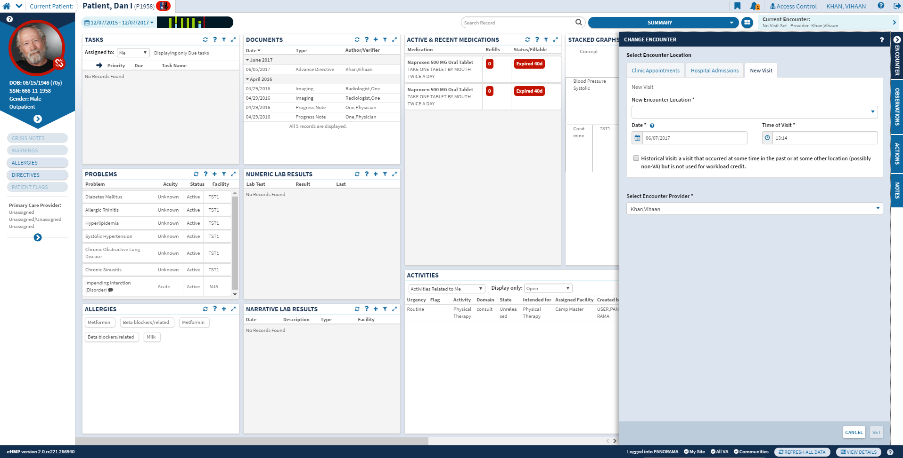
Example: eHMP 2.0 Medical Visit

Slide 37
Example: eHMP 2.0 Medical Visit
Easy-to-follow instructions
Screenshot format
Notice absence of “arrows”
User navigates through system to complete tasks, providing “user observation” opportunity
Good strategy
Back-end database and processing not complete
Integrated test environment not available

Slide 38
Practical Exercise: Creating a Flowchart
Develop a flowchart based on an existing protocol
Example protocol: Medication administration using bar code medication administration (BCMA)

Slide 39
Practical Exercise: Creating a Flowchart
Protocol Task List
Log in to the Computerized Patient Record System (CPRS) to check specific patient medications due
Log in to Pyxis and withdraw one medication at a time
Check medication for five rights (drug, route, time, dose, patient)
Take unopened medications to patient room with workstation on wheels (WOW) / BCMA scanner (unless scanner is at bedside)
Log in to CPRS
Notes:
This is from an RN medication administration training using a simulation laboratory for student RNs.

Slide 40
Practical Exercise: Creating a Flowchart
Protocol Task List
Scan patient's ID bracelet (this opens correct patient chart in eMAR)
Right Patient: confirm verbally with two identifiers (Name & DOB)
Scan meds you are about to administer with BCMA scanner (green light signals successful scan, red light signals error in scan)
Click the Accept button
Verify medication administration and add signature
Log out from CPRS/END

Slide 41
Building the flowchart
START: Log into CPRS
Log into Pyxis and withdraw one medication at a time
Check medications for 5 rights:
Right drug, route, time, dose, patient with order
Does check pass all 5 rights?
Take unopened med(s) to patient’s room with WOW/BCMA scanner
Yes
No
Stop and respond to alert
STOP
Stop medication and evaluate
Yes
No
Receive a barcode alert?
Confirm patient?
Scan the patient’s ID bracelet
Confirm verbally the correct patient with two identifiers (name and DOB)
Log into CPRS and identify co-signer if needed
Yes
No
Scan the med(s) you are about to administer
Click Accept
Verify medication administration and add signature
Log Off/END
Notes:
This flowchart is made from the protocol. So now what you would do is watch the student RNs in the simulated environment and see if they are matching the workflow. You can make notes on the mapping to identify where there are discrepancies, something missing, any issues, etc.

Slide 42
Group Activity: Speed Quiz
In CDS intervention evaluation, what is a “scenario”?
Answer: A story or narrative to set the stage for interactions with CDS interventions

Slide 43
Group Activity: Speed Quiz
After developing a scenario, what is the next step?
Answer: Develop a task list

